Slide 1
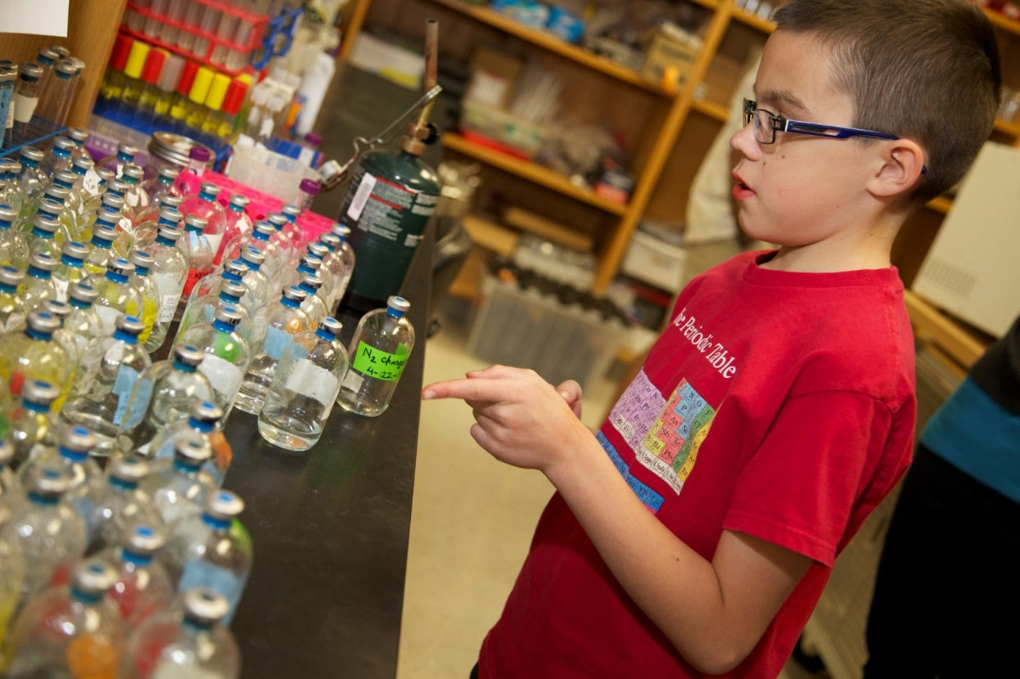

The Power of Science
Notes:
So Justin highlighted some of DRI’s notable contributions to the global research community and the positive implications of new scientific discoveries for not only Nevada, but the rest of the world. But who will continue this work once faculty member like Richard decide to retire from his respective field?
Who will take his place? Will Nevada’s youth be poised to pick up where he left off? And maybe an even more important question to ask is, would they even be interested in doing so?

Slide 2

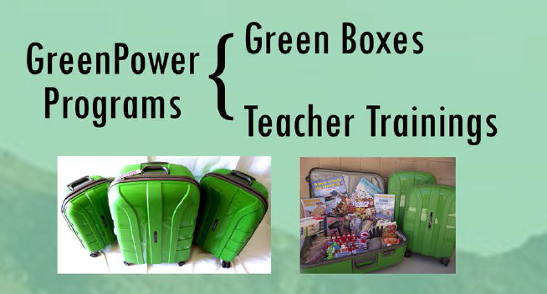
DRI’s Connection to K-12 Education
GreenPower Mission
To support Nevada's PreK-12 educators in science-based, environmental education by providing the tools, resources, and knowledge they need, so all students acquire the knowledge and skills needed to work, live and contribute in our community.
GreenPower Vision
We aim to increase scientific knowledge and understanding of the earth's environment, promoting preservation of diverse ecosystems, advancing responsible resource management, and improving human health and welfare.
Notes:
We agree that the need to entice student interest in science, technology, engineering and math is greater than ever. And that’s where GreenPower comes in.
READ MISSION & VISION
Really what we want to do is translate all of the cutting edge research that is being conducted and 21st technology that is being developed here at DRI into tangible classroom tools and resources.
As you may have gathered from our mission statement, we do this in a unique way. The model we use targets the educators, as they are the experts in their respective field. Although we see great value in having professionals come into the classroom to talk about their work in our Storm Peak Laboratory, for example, we can reach more students by empowering the educator with both the background knowledge and confidence to disseminate that same information to their students.
We’ve created a two pronged program that aims to do just that.

Slide 3
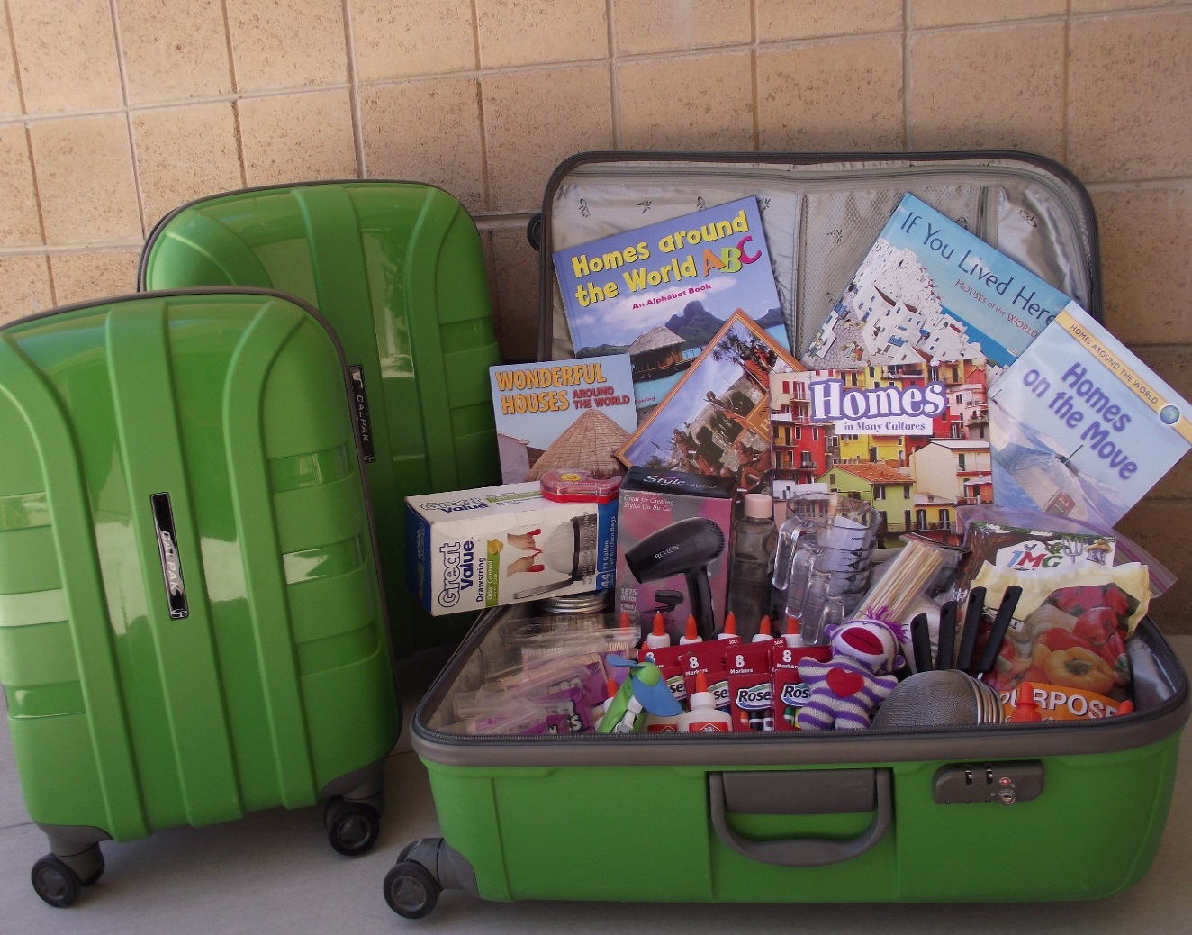
Green Boxes
Self-contained teaching kits provide educators with hands-on science experiments.
Standards-based lessons are designed to enhance student literacy in various STEM subject areas.
Aligned with Next Generation Science Standards
FREE of cost to any educator in Nevada!
Notes:
BULLET 1: Our Green Boxes include active learning materials that engage students directly with hands-on projects and experiences which are meant to build critical thinking and problem solving skills. These kits are designed to drive student inquiry and excitement for STEM by exposing them to subject matter and specialized equipment they might otherwise not have access to.
BULLET 2: Each Green Box includes about a unit’s worth of lessons, which equates to about 1 – 2 weeks’ worth of activities. We include everything the teacher will need to conduct the labs, from multimeters, miniature wind turbines, and salinity meters TO paper, pencils, glue etc. The unfortunate reality is most teachers, especially those at the elementary level, have to dig into their own pockets if they would want to use certain materials in the classroom.

Slide 4
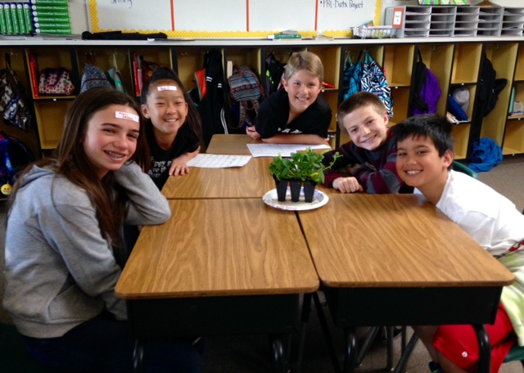
Soil Science (6-12) Green Box
Students are tasked with:
Simulating how soil is formed.
Identifying various types of soil.
Discovering how the properties of soil indicate what plants will thrive in that environment.
Understanding the compost food web, with an emphasis on the vital role worms play in composting.
Determining the characteristics of a worm’s ideal habitat.
Sepulveda Elementary School – 5th grade classroom
Notes:
BULLET 1: Our Green Boxes include active learning materials that engage students directly with hands-on projects and experiences which are meant to build critical thinking and problem solving skills. These kits are designed to drive student inquiry and excitement for STEM by exposing them to subject matter and specialized equipment they might otherwise not have access to.
BULLET 2: Each Green Box includes about a unit’s worth of lessons, which equates to about 1 – 2 weeks’ worth of activities. We include everything the teacher will need to conduct the labs, from multimeters, miniature wind turbines, and salinity meters TO paper, pencils, glue etc. The unfortunate reality is most teachers, especially those at the elementary level, have to dig into their own pockets if they would want to use certain materials in the classroom.

Slide 5
Grizzly Gizzards
Next Generation Science Standards
MS-LS1-3. Use argument supported by evidence for how the body is a system of interacting subsystems composed of groups of cells.
HS-LS1-2. Develop and use a model to illustrate the hierarchical organization of interacting systems that provide specific functions within multicellular organisms.
Notes:
BULLET 1: Our Green Boxes include active learning materials that engage students directly with hands-on projects and experiences which are meant to build critical thinking and problem solving skills. These kits are designed to drive student inquiry and excitement for STEM by exposing them to subject matter and specialized equipment they might otherwise not have access to.
BULLET 2: Each Green Box includes about a unit’s worth of lessons, which equates to about 1 – 2 weeks’ worth of activities. We include everything the teacher will need to conduct the labs, from multimeters, miniature wind turbines, and salinity meters TO paper, pencils, glue etc. The unfortunate reality is most teachers, especially those at the elementary level, have to dig into their own pockets if they would want to use certain materials in the classroom.

